Slide 1
Sprint 1 Presentation
By Buddis
Formerly Known as Piratez

Slide 2
Updates to the BRD & Management Plan
Updated our main goal and premise of our app to be academics related
Changed our target from web app to mobile app
Demographic & Primary Market Research Analyzed
User ease of use and efficiency prioritized
Changed our habits as a team for biweekly sprint team meetings

Slide 3
User platforms
We originally planned this application to be a website but due to our primary market research, we decided to move this to a mobile app
This would be more convenient for students since phones are much more convenient for them to use.
We also do not have to learn a new language to program the application

Slide 4
Key user stories
Create post
A user can create a post with the title of the class, subject, and description of what they are struggling with in the class
Creating a studi session
A user can create a studi session with another user
A user cannot already be in another studi session with another user
Accepting a studi session
A user can accept a studi session from another user
Allows the user to join a studi session

Slide 5
In progress user stories
Currently all of the user stories are in progress
We have not had a code release yet
For each user story there should be at least 3-6 tasks

Slide 6
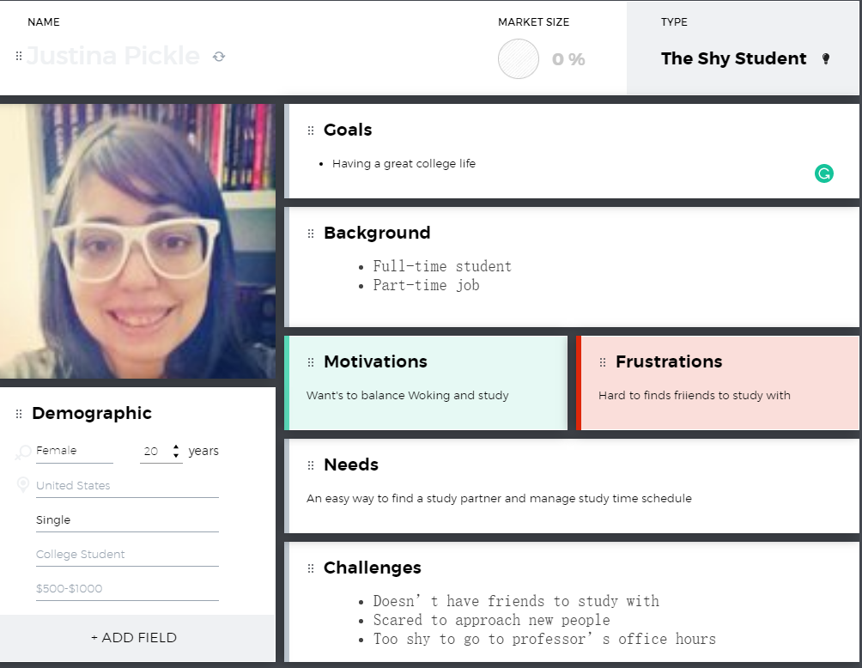
User Personas
The shy student
The new student
The international student

Slide 7
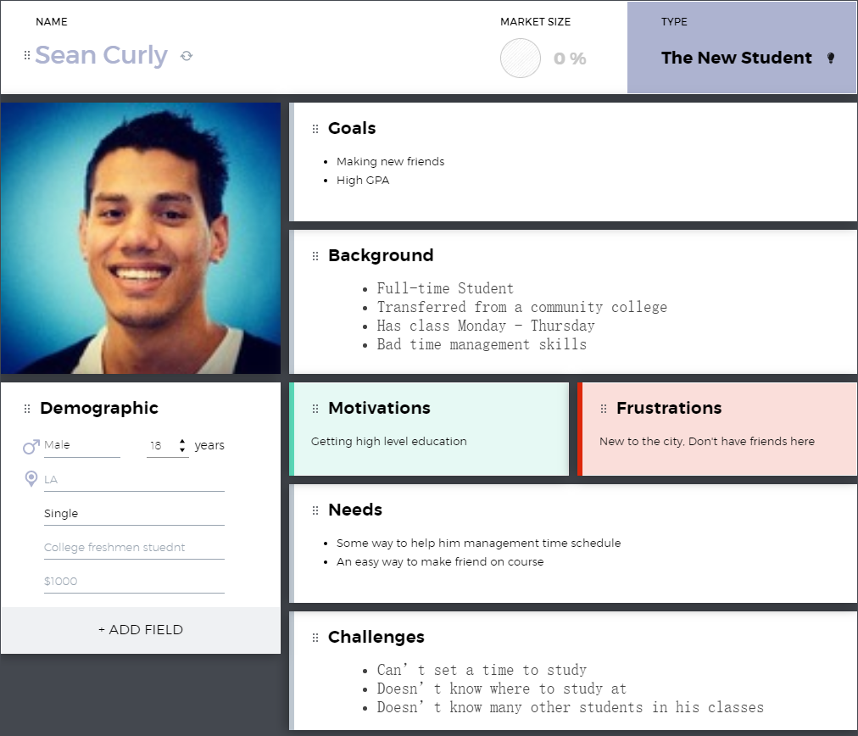
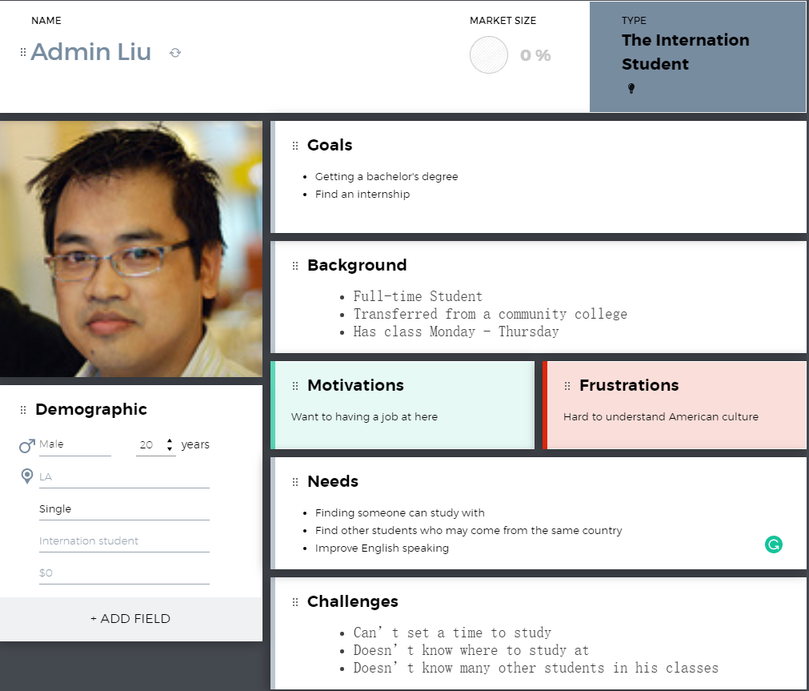
User Personas
Notes:
Mention or add the third persona

Slide 8
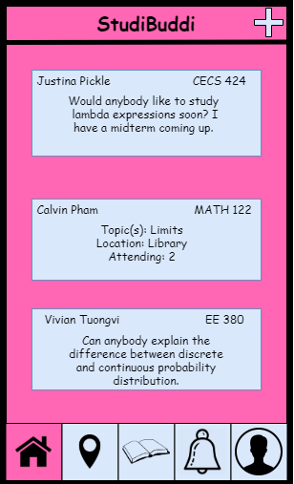
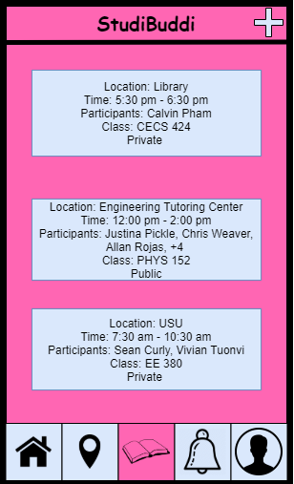
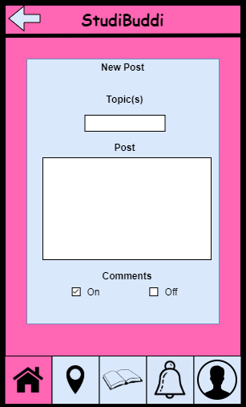
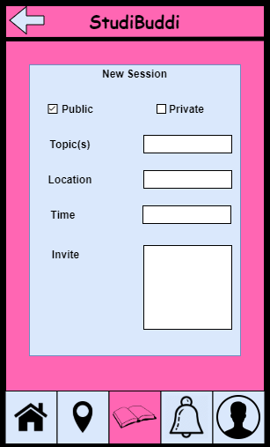
Wireframes

Slide 9
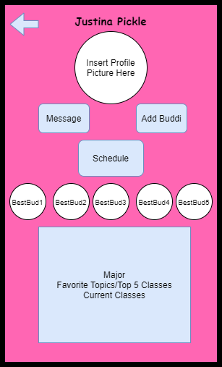
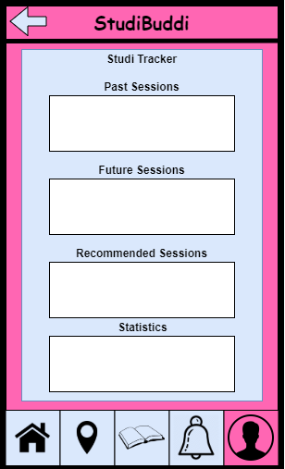
Wireframes

Slide 10
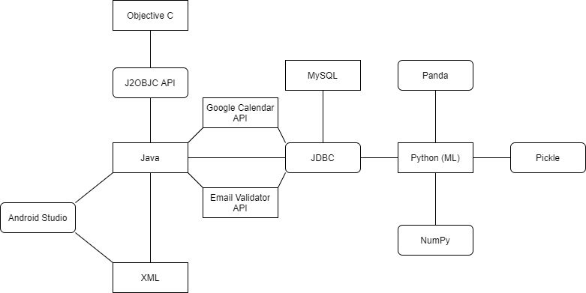
Frameworks Diagram

Slide 11
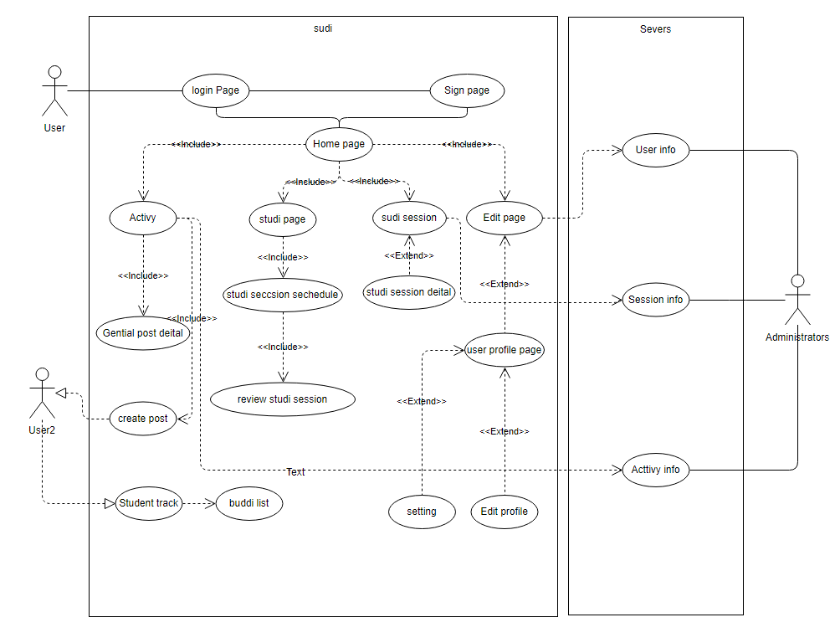
Use case Diagram

Slide 12
Android vs iOS Tradeoff Analysis
Criterion | Weight | Android | Apple
Our Technological Experience | 20 | 15 | 5
Accessibility | 10 | 8 | 7
Audience | 10 | 7 | 8
Timeline | 5 | 3 | 4
Software Features | 20 | 15 | 10
Hardware Features | 25 | 23 | 20
Performance | 10 | 8 | 8
Total | 100 | 79 | 65

Slide 13
Future Iterations
Generality
Available on both Mobile system
Safety
User safety
When user going to meeting someone should know
Data safety
Avoid data breach
Privacy
Even data breach happened, user privacy should be safe
Accessibility
Adding more useful feature in future

Slide 14
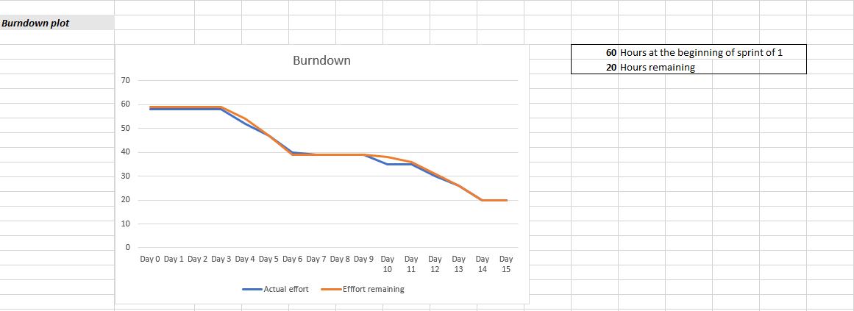
Burndown Chart

Slide 15
Sprint Retrospective (Review)
60 story points planned
40 completed
Tasks planned and completed
Product requirements document
Architecture and design document
Tasks planned and not completed
Business requirements documents
Did not set up database, but began login page

Slide 16
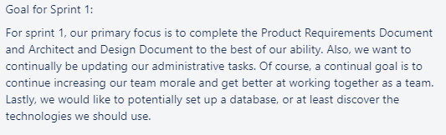
Sprint Goal

Slide 17
Sprint Retrospective
Great - continue doing
Performed well as a team on PRD, led to a score we were happy with
High team morale
Consistently meeting outside of class
Poor - stop doing
Still not working at a consistent pace, waiting until specific days to do lots of work
Need better task delegation
Start doing
More coding
Notes:
hello

Slide 18
Plan for Next Sprint
Front end - Hunter
Android Development
Back end - Tanner & Oscar
Database Design, APIs
Graphic Design - Hunter and Oscar
Graphic Design of app
Documentation and Planning - Tymee and Luke
Updating our BRD, ADD, etc. as we go on
Language & Framework Learning - Everyone

Slide 19
Planned by end of Sprint 2
Code release - software demo of mobile app
Database design release
Completely redone Business Requirements Document submitted with our new idea
Select a Machine Learning Model for our needs

